Slide 1

Unit 1: Lesson 2
Charlie’s Angels
U ovoj ćeš lekciji ponoviti pridjeve za vanjski i unutarnji opis ljudskih osobina te dodati nove.

Slide 2
Task 1: Translate the words and expressions into Croatian.
Task 2: Tick the words and expressions that best describe your best friend.
Task 3: Circle the words that best describe you.
šašav
ambiciozan
kreativan
osoba koja provodi puno vremena za računalom
pametnjaković
pristojan
tvrdoglav
sportski
osoba koja je ovisna o svom mobilnom telefonu
nervozan
spretan, vješt
nespretan
bez predrasuda
knjiški moljac
sveznalica

Slide 3
Task 4: Listen to the dialogue and match the names to the pictures.
https://www.e-sfera.hr/dodatni-digitalni-sadrzaji/84305061-6cf3-426e-9e99-aa2d5c2ae970/
2
1
4
3

Slide 4
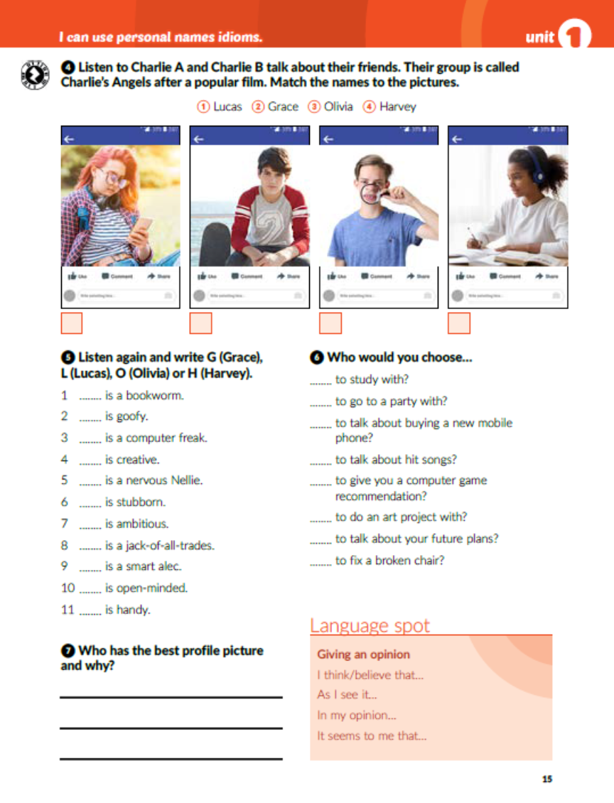
Task 5: Listen and write G (Grace), L (Lucas), O (Olivia) or H (Harvey).
https://www.e-sfera.hr/dodatni-digitalni-sadrzaji/84305061-6cf3-426e-9e99-aa2d5c2ae970/
O
H
L
G
O
O
H
L
H
G
L

Slide 5

Task 6: Who would you choose…

Slide 6

Task 7: Who has the best profile picture and why?

Slide 7
Open your workbook, page 8
Task 1: Read the text and find 5 verbs, 5 nouns, 5 adjectives, 5 adverbs, 5 pronouns and 5 prepositions.
come cry offer accept
sandwich lunch box teacher brother
open-minded, friendly goofy shy
never histerically, sometimes often
I his our we
at out about to

Slide 8
a nervous Nellie
goofy
a smart alec
ambitious
a phone addict
open-minded
Task 2: Complete the sentences with the words from the box.
handy
polite
a jack-of-all-trades
stubborn

Slide 9
Task 3: Choose one of the profile pictures and describe it.

Slide 10

Otvori sljedeće poveznice, te odaberi PLAY AND LEARN!
https://wordwall.net/play/18514/994/780
https://wordwall.net/play/18515/861/366

